Slide 1
Legal Strategies to Obtain Testing Accommodations for High Achieving Immigrants with Learning and Non-Traditional Vision Disorders
Jacobus tenBroek Disability Law Symposium
March 26, 2021
Allison Hertog, M.A., J.D.
San Zhang M.D.
Notes:
.

Slide 2
About Us
Sen Zhang, M.D.
Allison Hertog, J.D., M.A.
National practice representing high-achievers
with disabilities on High-Stakes Standardized Exams
Pre/non litigation approach
IDEA attorney who is a former special ed. teacher
M.A. Special Education
High-achiever with disabilities who was diagnosed
after law school
Certified Physician from China
Highly-achieved before coming to USA
Published 20+ articles in Research field
Diagnosed with Vision Disability in adulthood
Passed all USMLE exams with accommodations
After failing without accommodations
Foreign Medical Degree certificated by ECFMG

Slide 3
Content of This Presentation
Theme: Immigrants* Are Less Likely to be Identified as Disabled and/or At the Same Rate
and that Impacts Getting Accommodations on Exam
What Problems Disabled Immigrant Students Face During Educational Careers?
How the Accommodations Application Process Negatively Impacts Disabled Immigrants, and Particular Impact on U.S. Medical Licensing.
Background on ADA Law re Testing Accommodations Generally
Two Effective Legal Strategies Can be Specifically Tailored for Immigrant Populations: “Condition, Manner or Duration” and Explanation for Delay in Diagnosis.
Dr. Zhang’s experience getting accommodations on the medical boards as an immigrant with a non-traditional vision impairment
* Immigrants = immigrants and children of immigrants who speak another language at home
Notes:
Focus on medical licensing because of the high percentage of US physicians are immigrants, about 25%. Couldn’t find stats on children of immigrants.
For comparison, less than 10% of US lawyers are immigrants. http://www.repository.law.indiana.edu/cgi/viewcontent.cgi?article=1576&context=ijgls

Slide 4
Preliminary Issue: Three Categories of Immigrants Who May Need Accommodations
“English Learners” up to Age 21
Defined under Title III Every Student Succeeds Act
College Board and ACT - nearly automatic accommodations with appropriate documentation on receipt of current services in school
English Learners (LEP) Students with Disabilities
Test in native language with bilingual evaluator to show that deficits exist in both language assessments
Submit an English proficiency test, such as TOEFL, to show that applicant’s deficits are not due to Limited English Proficiency, but due to the disability.
Accommodations for Immigrants/Children of Immigrants with Disabilities on High-Stakes Exams who may not be LEP
Primarily the subject of this talk.
Notes:
As of 2015 when the Every Student Succeeds Act (ESSA) was passed, English Learners is the term used to describe students up to age 21 whose English proficiency impacts their learning. (ESEA Section 8101(20)). The College Board and the ACT now use that definition to consider eligibility for accommodations based on English Learner status with documentation. LEP (Limited English Proficiency) refers to a person who is not fluent in the English language. Both LEP and English-language learner are terms used by OCR.

Slide 5
General Educational Problems Immigrant Students Face Which Later Impact Ability to Get Accommodated
Poverty
Lower preschool enrollment
Due to legal status, language barriers, experience in home country
Ability of parents to speak and read English
Provision of help in school
Grade repetition or early tracking to lower academic levels
Bias
Teacher bias against presence and abilities
Family or cultural bias against identification of disability
Testing Board bias
Delayed placement in special education
ESL status confounds identification as LD
Notes:
Items in light blue can be easily used to explain a delayed diagnosis, which is important under the ADA.
Hibel, J., & Jasper, A. (2012). Delayed Special Education Placement for Learning Disabilities among Children of Immigrants. Social Forces, 91(2), 503-529. Children of immigrants have comparatively lower odds of being placed in special education, but demonstrate increased risk of failure as school years progress. This may be a result of being labeled and tracked in classes for students who are English Language Learners.

Slide 6
Applications for Testing Accommodations: Document Requirements Negatively Impact Immigrants
History of Accommodations in School and on Tests
History of Disability Diagnosis
Evidence of Current Disability
Medical Records
Psychoeducational Testing

Slide 7
ADA Background: Law Supporting Accommodations for High Achievers with Disabilities
ADA Standards for Disability Status and Need of Accommodations
Before the ADA was amended in 2008, high-achievers with disabilities weren’t explicitly included in the ADA.
(DOJ, Title II & III Regulations to ADA Amendments Act of 2008. 28 CFR Parts 35 & 36 [testing and higher education])
ADA standards are different from the one which psychologists use to diagnose disability
“Physical or mental impairment that substantially limits one or more major life activities
Major life activities e.g., seeing, performing manual tasks, learning, reading, concentrating, thinking, communicating
Substantially limits = below average RANGE in this context
Notes:
https://www.ada.gov/regs2014/testing_accommodations.html#_ftn2 Has basic rules/regs with citations.
https://www.eeoc.gov/laws/guidance/questions-and-answers-final-rule-implementing-ada-amendments-act-2008

Slide 8
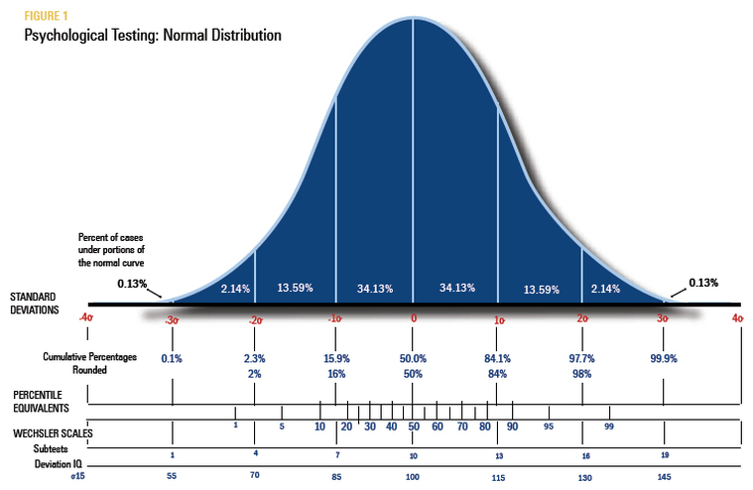
What Does Below the Average Range Mean?

Slide 9
Summary of Consent Degree with LSAC
CA Dept of Fair Employment and Housing (DFEH) v. LSAC Consent Decree (2014):
Discontinue practice of "flagging" scores of individuals who received accommodations.
Provide the same or similar accommodations to individuals who have previously received them on tests for admission to any post-secondary educational institutions
Request for documentation shall be reasonable
Must give "considerable weight to accommodations previously received under 504 or IEP plan.
May not refuse accommodations based solely on the fact that the applicant has not previously received accommodations.
Appointed members to “Best Practices” panel of experts – report LSAC will be required to follow. Final Report 2/6/15.

Slide 10
Legal Strategies to Get Accommodations for Immigrant High-Achievers with Disabilities
Two Key Legal Paradigms to Overcome Bias of Testing Boards and Demonstrate Need for ADA Accommodations
“Condition, manner or duration” under which a major life activity can be performed can be used to determine whether person has a disability (ADA EEOC 2016 Regulations)
“Bona fide reasonably supported reasons for late diagnosis” Settlement Agreement btwn DOJ and NBME, Feb 23, 2011.
Other Legal Arguments
“Mitigating Measures”
Positive effects can not work against the person in determining whether someone has a disability
Positive effects can be used to determine whether accommodations are needed
“Qualified Professional” recommends 50% extended time.
Notes:
Mitigating measures eliminate or reduce the symptoms or impact of an impairment. The ADAAA non-exhaustive list of examples of mitigating measures. They include medication, medical equipment and devices, prosthetic limbs, low vision devices ( e.g., devices that magnify a visual image), hearing aids, mobility devices, oxygen therapy equipment, use of assistive technology, reasonable accommodations, and learned behavioral or adaptive neurological modifications. In addition, the final regulations add psychotherapy, behavioral therapy, and physical therapy to the ADAAA's list of examples. [Section 1630.2(j)(5)]
The ADAAA and the final regulations direct that the positive (or ameliorative) effects from an individual's use of one or more mitigating measures be ignored in determining if an impairment substantially limits a major life activity

Slide 11
Strategy 1: Utilize “Condition, Manner or Duration” Paradigm
The ‘‘condition’’ or ‘‘manner’’ or “duration” under which a major life activity can be performed
“…the condition or manner under which a major life activity can be performed may refer to
the “way an individual performs a major life activity.”
e.g., speaking aloud
“how performance of a major life activity affects the individual with an impairment.”
e.g., causes pain or blurry vision requiring breaks
“the extent to which a major life activity… can be performed.”
e.g., causes substantial fatigue
Condition, manner, or duration may also suggest
the amount of time an individual has to expend when performing a major life activity because of the effects of an impairment
even if the individual is able to achieve the same or similar result as someone without the impairment.
Notes:
Assessing the condition, manner, or duration under which a major life activity can be performed may include consideration of the difficulty, effort, or time required to perform a major life activity; pain experienced when performing a major life activity; the length of time a major life activity can be performed; and/or the way an impairment affects the operation of a major bodily function.
[Section 1630.2(j)(4)(i) and (ii) and corresponding Appendix section]
Example of condition: Can only read with comprehension if speaks the words aloud.

Slide 12
Recent Case Law Analysis of “Condition, Manner or Duration”
Berger v. Nat’l Bd. of Med. Examiners, No. 1:19-CV-99, 2019 WL 4040576 (S.D. Ohio Aug. 27, 2019) (granting p’s motion for a prelim injunction), LEXIS 77517 (S.D. Ohio May 1, 2020) (granting d’s motion for an indicative ruling to vacate prelim injunction)
Berger’s dual language exposure was used by the testing board to try to undercut the presence of a disability.
Ramsay v. Nat’l Bd. of Med. Examiners, 968 F.3d 251 (3d Cir. Jul 31, 2020), No. 20-1058, 2021 WL 850645 (S. Ct. Mar. 8, 2021)(petition for writ of certiorari denied)
No bilingual or immigrant issue. Student’s diagnosis of ADHD and Dyslexia was evident back in elementary school.
Plaintiffs are high-achievers who did not receive formal accommodations until later in their academic careers. Ps won preliminary injunctions for disability discrimination. Used the Condition, Manner or Duration paradigm to succeed.
Testing Boards and Higher Ed should emphasize consideration of “limits” rather than “outcomes.”
Plaintiff with a learning disability may achieve a high level of academic success, but may be substantially limited in one or more of the major life activities of reading, writing, speaking, or learning because of the additional time or effort he or she must spend to read, speak, write, or learn compared to most people in the general population.
Notes:
Berger: Student with ADHD who was seeking extended time accommodations. Bias of the medical testing board (NBME) was illustrated in this case. The NBME turned his bilingualism on its head, using it against him. He grew up in a home where French was spoken about 10% of the time. NBME’s psychologist concluded that he was not learning disabled at all, despite getting accommodations for such since elementary school, and that his current deficient reading scores were the result of “the early effects of a language difference.”
Ramsay:

Slide 13
Strategy 2: Give Explicit Reasons for the Delay in Diagnosis
“Bona fide, reasonably supported reasons for the late diagnosis” must be considered.
Settlement Agreement DOJ and NBME (2/23/2011)
Examples
Schools did not use timed testing
Fear of Stigma
Receipt of informal accommodations
Lack of legal rights for SWD in home country
Poor socio-economic community in which public schools often violate the IDEA, failing to identify and serve SWD
Lack of funds or no ability to get a psycho-ed evaluation
Final Report of the Best Practices Panel Consent Decree. (2/6/15) P.14.

Slide 14
Useful Assessments for Evaluations of High Achievers
SATA – timed and untimed reading, writing and math
Nelson Denny Reading Test
TOMAL-2, D-KEFS, TOVA – cognitive processing and attention
WJ IV – visual processing-for no scantron sheet
Optometric Assessments – addressed today by Dr. Zhang
TOWRE-2 - timed measure of decoding efficiencies
Anxiety assessments – Neo PI, MAPI AND

Slide 15
Why is Medical Licensing a Particular Problem for Immigrants?
Growing Segment of US Physicians: About 25% of are Immigrants
United States Medical Licensing Exams (USMLE) scores
Significant part of the selection process in residency programs.
Three tests (“steps”) in initial medical licensing
Standardized testing is problematic for advancement for underrepresented populations.
Research: Increasing the diversity of the physician workforce may assist in eliminating health disparities in the US.
Minority physicians more likely to care for minorities, in underserved communities.
Notes:
A large and growing segment of US physicians are immigrants. About 1/7 people in the US are immigrants, whereas about ¼ US physicians are immigrants.
The impact of United States Medical Licensing Exam (USMLE) step 1 cutoff scores on recruitment of underrepresented minorities in medicine: A retrospective cross‐sectional study, Health Sci Rep. 2020 Jun; 3(2): e2161.
The damage of a low score or multiple attempts to pass any step - do not obtain any residency, screened out by a computer algorithm. If you do not complete a residency, you can not practice in the states.

Slide 16
Dr. Sen Zhang’s Case
Non-Traditional Vision Disordered and Bilingual Immigrant
Couldn’t obtain accommodations using the same documentation
as visually impaired student who automatically receive double time
Demonstrated the impact of the disability on major life activities
using vision and reading assessments
Differentiated disability from learning disorder and English proficiency
Utilized Legal Paradigms
Condition, Manner, Duration of vision and reading
Rationales for Late Diagnosis

Slide 17
Who am I and why I am speaking
- Immigrant
- Received foreign education until M.D. (certified physician)
- English is my Second Language
- Previously highly achieved until having difficulty with USMLE/medical board exams (Step 1, 2CS, 2CK, 3).
Education
/knowledge?
English not native language?
Lack strategy taking U.S. exam?
Did not work hard enough?
Dismissed deteriorating vision symptoms =>
Vision disability!
Could possibly cause a low score

Slide 18
Test Accommodations Request (double time) with NBME
Request denied -> Appeal (with Allison) -> Approved -> Passed the USMLE step immediately
Q1: How a vision disability influences an adult’s high-stake test performance (e.g., USMLE)?
Q2: What factors delayed my diagnosis until adulthood?

Slide 19
Vision – Reading/Learning – Comprehension
- Vision/ Visual Acuity: 20/20, ability to see objects clearly. Usually the only skill assessed in a school vision screening. Can be corrected by wearing glasses.
- Clear eyesight (20/20) ≠ No reading problems
- Reading requires the integration of a number of different vision skills:
Sensory
- Acuity
- Eyeball
- Eyesight
- 20/20
- Focusing
- Myopia control
- Ocular health
Motor
Eye Movements:
(Oculomotor Dysfunction)
- Saccade
- Fixation
- Scanning
- Tracking
- Pursuits
Eye Teaming:
- Binocular vision (Convergence insufficiency)
- Eye-motor coordination
- Stereoscopic vision
- Depth perception
- 3-D
Perceptual
- Laterality and directionality
- Visual memory
- Visual discrimination
- Visual spatial
- Visual figure-ground
- Visual closure
- Visual-auditory integration
Cognitive
-Visual attention
-Hemispheric utilization

Slide 20
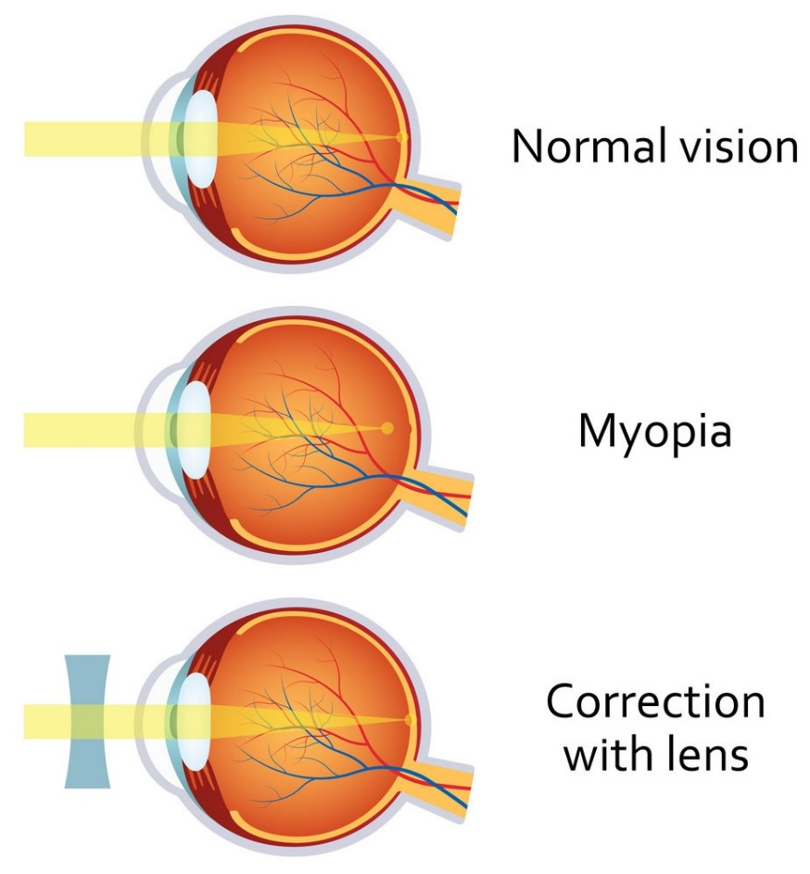
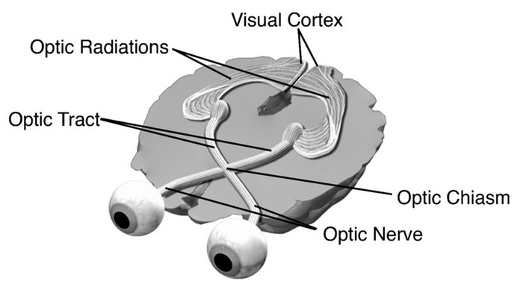
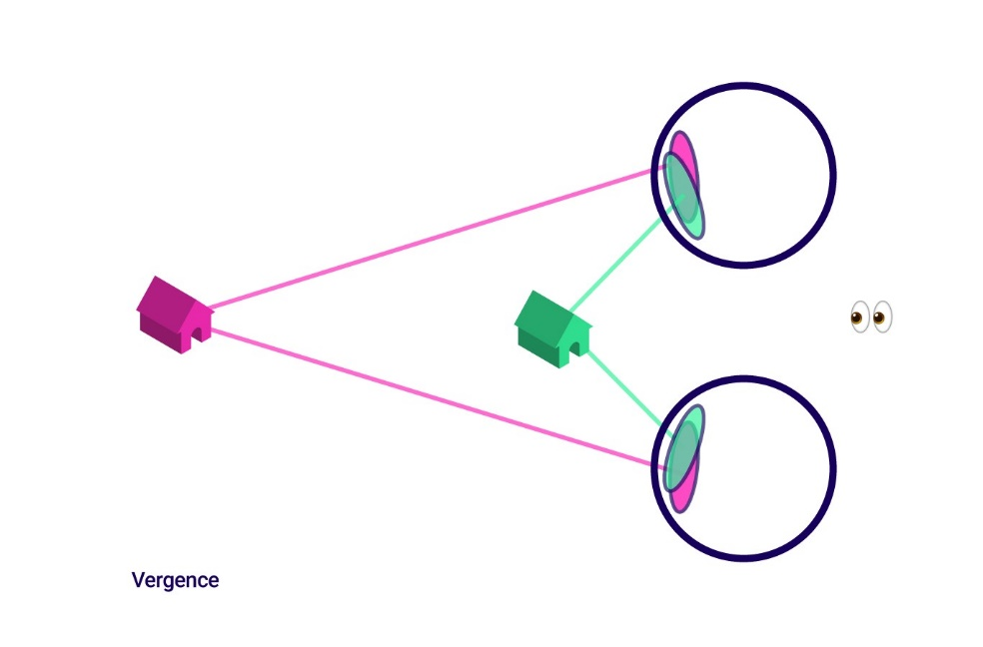
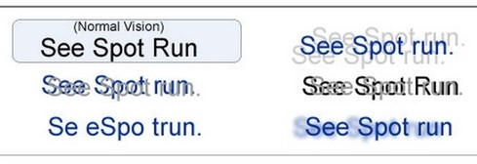
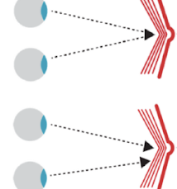
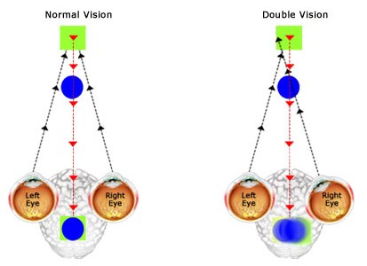
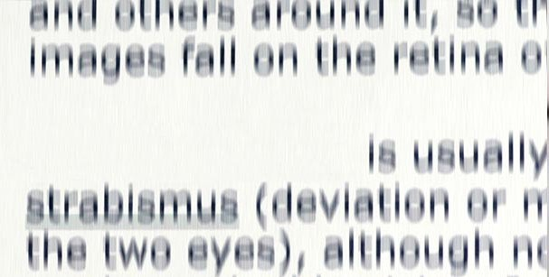
Vision
Reading
Saccadic eye movements: the ability of the eyes to accurately “jump” from one target to another.
Fixation: the ability to “hold” the eyes steady without moving off the target
Pursuit eye movements: the ability of the eyes to accurately “follow” a moving target.
Eye Strain,
Soreness,
Tearing,
etc…
Force fast reading=> loss memory & comprehension

Slide 21
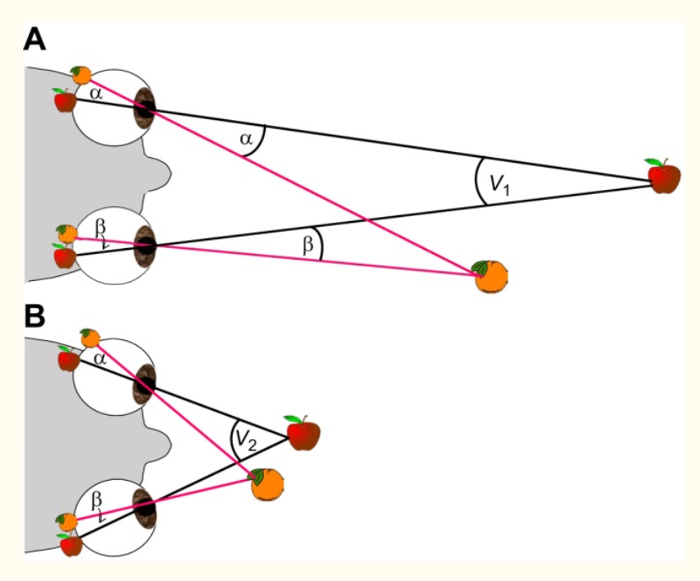
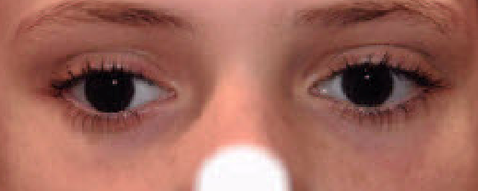
Pathogenesis: Convergence Insufficiency
Influence depth detection
J Exp Biol. 2017 Jul 15; 220(14): 2502–2512.
Stereopsis in animals: evolution, function and mechanisms
Vivek Nityananda^{1,2,*} and Jenny C. A. Read²
21

Slide 22
How Oculomotor Dysfunction Influences Test Performance
Sample USMLE Test Question
After being severely beaten and sustaining a gunshot wound to the abdomen, a 42-year-old woman undergoes resection of a perforated small bowel. During the operation, plastic reconstruction of facial fractures, and open reduction and internal fixation of the left femur are also done. Thirty-six hours postoperatively, she is awake but not completely alert. She is receiving intravenous morphine via a patient-controlled pump. She says that she needs the morphine to treat her pain, but she is worried that she is becoming addicted. She has no history of substance use disorder. She drinks one to two glasses of wine weekly. Which of the following initial actions by the physician is most appropriate?
Reassure the patient that her chance of becoming addicted to narcotics is minuscule
Maintain the morphine, but periodically administer intravenous naloxone
Switch the patient to oral acetaminophen as soon as she can take medication orally
Switch the patient to intramuscular lorazepam
Switch the patient to intravenous phenobarbital.
From www. usmle.org.

Slide 23
How Oculomotor Dysfunction Influences Test Performance
Oculomotor Dysfunction influenced an individual’s reading speed.
To process each question, examinee needs to 1) acquire the information from the question body by reading; 2) rationalize the correct choice from medical knowledge. Slow reading speed requires more time to complete first step.
Step 2 CK is a one-day (total 9 hour) examination:
8 blocks, each block = 60 mins with around 40 questions.
Total number of items will not exceed 318.
One of the effects of Oculomotor Dysfunction is reading difficulty. However, it is important to note that Oculomotor Dysfunction is not the same thing as Dyslexia. Oculomotor Dysfunction is an anomaly of the oculomotor system, while Dyslexia is a language-based disorder.

Slide 24
Sample Measurements to Demonstrate Ocular Motor Disfunction to Testing Boards

Slide 25
Why diagnosis has been delayed?
Education system difference:
Vision condition itself:
- very specialized field (hard to diagnosis);
- little is known;
could be developed in childhood,
but could be overlooked then, with worsening and diagnosis during adulthood.
● Test Taking Format: Pen and paper vs Computer
● Test Emphasis: Writing and drawing vs Intense Fast Reading
● Reading Required: Little vs Large
● Test Accommodation: Did not exist vs Common
● ADA: Did not exist vs Yes
● Culture Stereotype: Work Harder vs Disability?

Slide 26
Summary
Evaluation must show below the average range performance.
Distinguish impact of disability from English proficiency
Use the ADA “Condition, Manner and Duration” Paradigm
Rationale for Late Diagnosis to Include Documentation of Symptoms

Slide 27
Thank you

Slide 28
Allison Hertog, Esq., M.A. Hertog Education Law, PC Allison@MakingSchoolWork.law 213 290 3137

